Slide 1



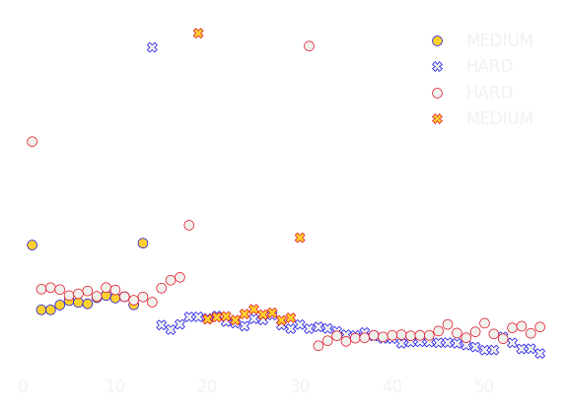

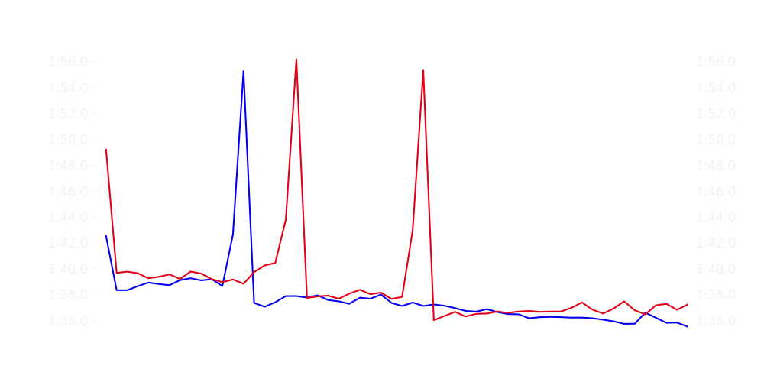
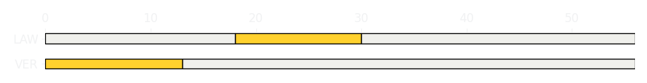
Chinese GP Race
Driver
Race Time
Race Time
Driver
Max Verstappen
1:29:29.433
1:30:27.245
Liam Lawson
Avg Lap Time
1:37.226
IQR
Gap
Gap
IQR
Avg Lap Time
1.812 s
-64.491 s
+64.491 s
2.701 s
1:37.743
Race Comparaison
Race Comparaison
Lap Advantage
44/56
Position
4
Safety Car Lap
0/56
Position
16
Lap Advantage
12/56
Lap Time Per Lap
Lap Time Per Lap
Tyre Strategy
Total Pit Stop Time
00:22.454 s
Pit Stops
1
Pit Stops
2
Total Pit Stop Time
00:44.891 s
Tyre Strategy

Slide 2

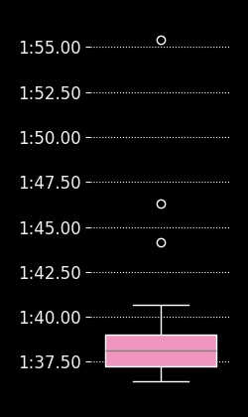
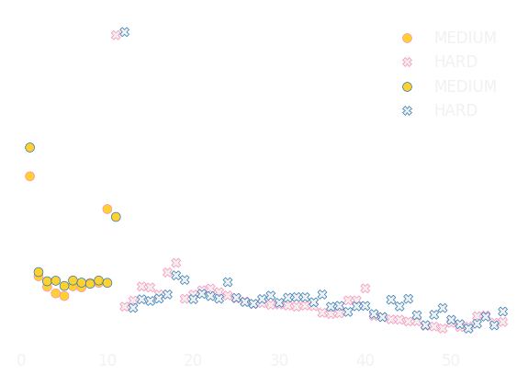
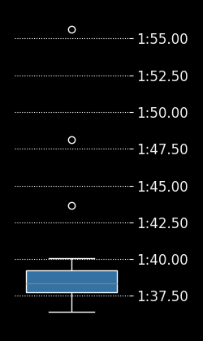
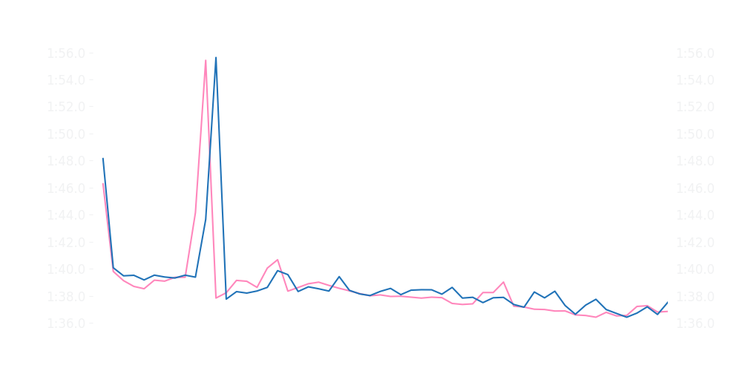
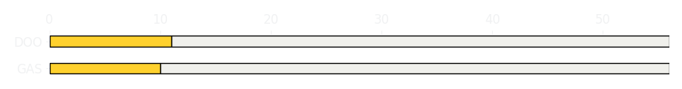
Chinese GP Race
Driver
Race Time
Race Time
Driver
Pierre Gasly
1:30:16.181
1:30:25.523
Jack Doohan
Avg Lap Time
1:38.121
IQR
Gap
Gap
IQR
Avg Lap Time
1.78 s
-11.206 s
+11.206 s
1.456 s
1:38.327
Race Comparaison
Race Comparaison
Lap Advantage
34/56
Position
11
Safety Car Lap
0/56
Position
14
Lap Advantage
22/56
Lap Time Per Lap
Lap Time Per Lap
Tyre Strategy
Total Pit Stop Time
00:23.138 s
Pit Stops
1
Pit Stops
1
Total Pit Stop Time
00:22.793 s
Tyre Strategy

Slide 3


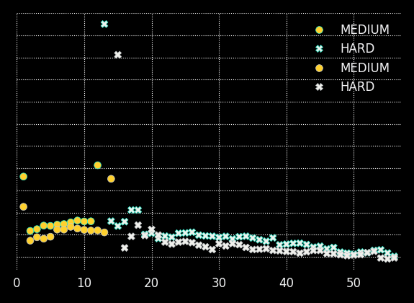

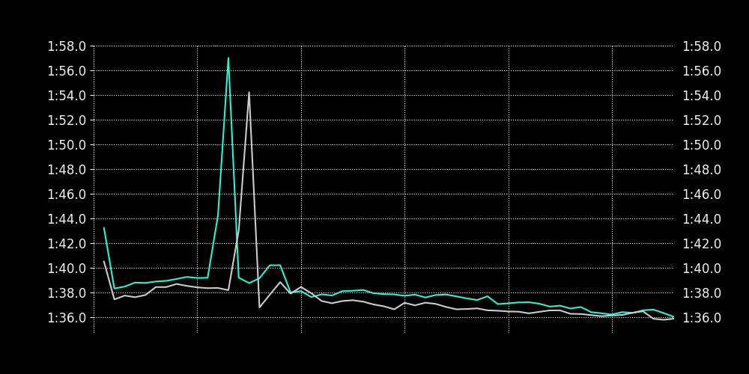
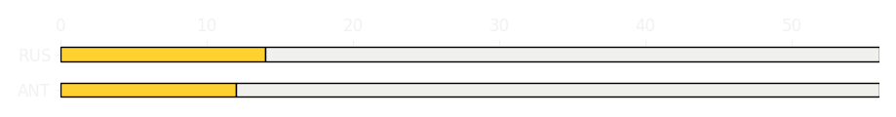
Chinese GP Race
Driver
Race Time
Race Time
Driver
Kimi Antonelli
1:30:05.766
1:29:25.841
George Russell
Avg Lap Time
1:37.859
IQR
Gap
Gap
IQR
Avg Lap Time
1.697 s
+42.651 s
-42.651 s
1.438 s
1:37.078
Race Comparaison
Race Comparaison
Lap Advantage
5/56
Position
8
Safety Car Lap
0/56
Position
3
Lap Advantage
51/56
Lap Time Per Lap
Lap Time Per Lap
Tyre Strategy
Total Pit Stop Time
00:22.675 s
Pit Stops
1
Pit Stops
1
Total Pit Stop Time
00:22.324 s
Tyre Strategy

Slide 4


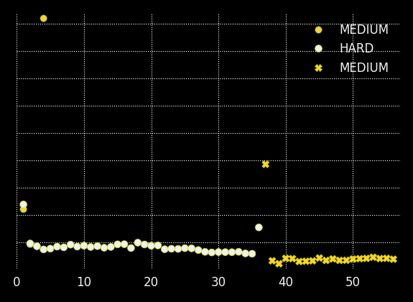

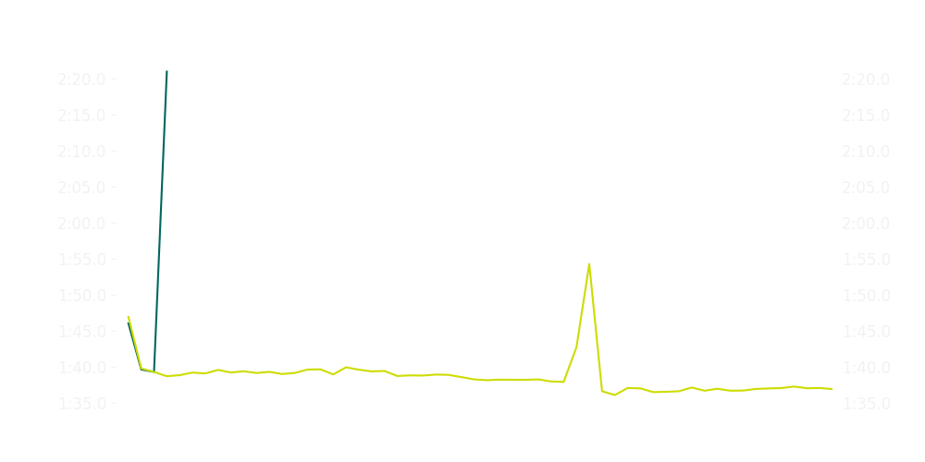
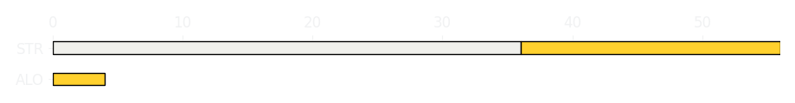
Chinese GP Race
Driver
Race Time
Race Time
Driver
Fernando Alonso
0:03:18.847
1:30:18.584
Lance Stroll
Avg Lap Time
1:39.591
IQR
Gap
Gap
IQR
Avg Lap Time
3.372 s
+52 laps
-52 laps
2.184 s
1:38.596
Race Comparaison
Race Comparaison
Lap Advantage
2/56
Position
12
Safety Car Lap
0/56
Position
12
Lap Advantage
54/56
Lap Time Per Lap
Lap Time Per Lap
Tyre Strategy
Total Pit Stop Time
0:00:00
Pit Stops
0
Pit Stops
1
Total Pit Stop Time
00:22.995 s
Tyre Strategy

Slide 5


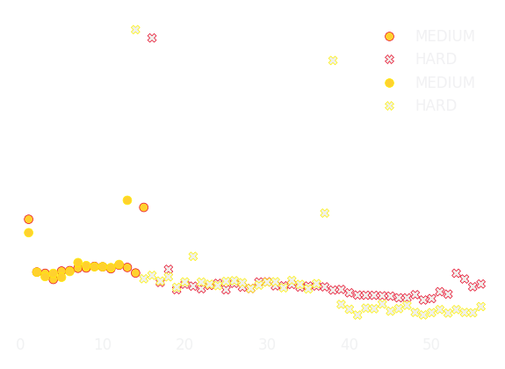

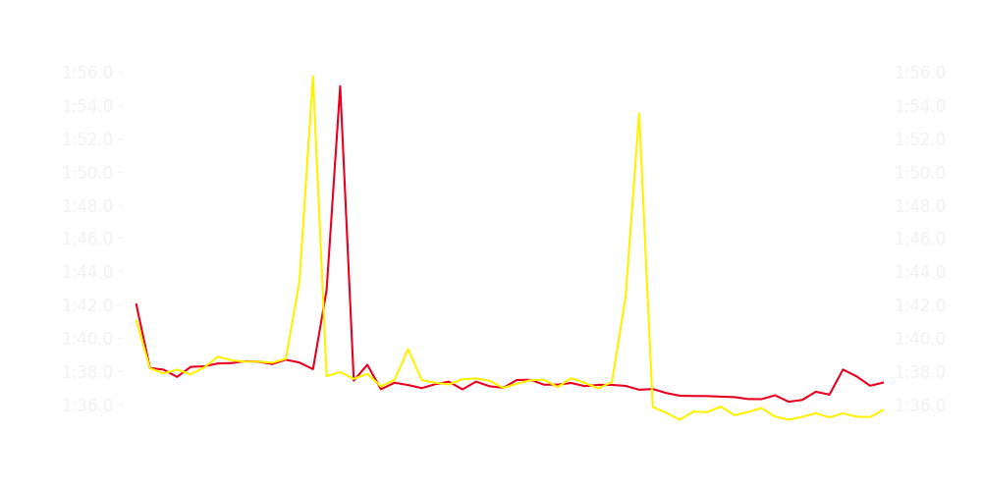
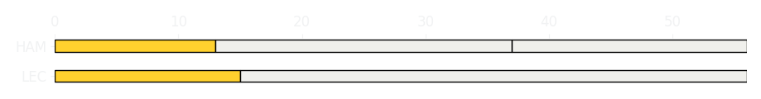
Chinese GP Race
Driver
Race Time
Race Time
Driver
Charles Leclerc
1:29:36.474
1:29:39.615
Lewis Hamilton
Avg Lap Time
1:37.198
IQR
Gap
Gap
IQR
Avg Lap Time
1.235 s
-2.17 s
+2.17 s
2.455 s
1:37.428
Race Comparaison
Race Comparaison
Lap Advantage
23/56
Position
5
Safety Car Lap
0/56
Position
6
Lap Advantage
33/56
Lap Time Per Lap
Lap Time Per Lap
Tyre Strategy
Total Pit Stop Time
00:22.151 s
Pit Stops
1
Pit Stops
2
Total Pit Stop Time
00:44.752 s
Tyre Strategy

Slide 6


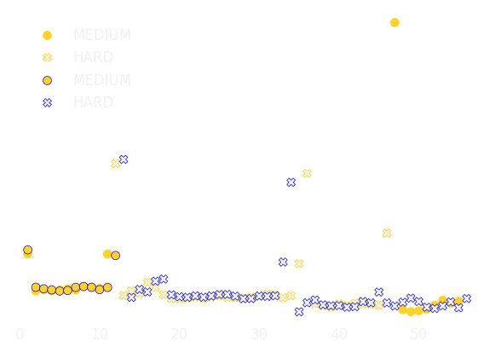

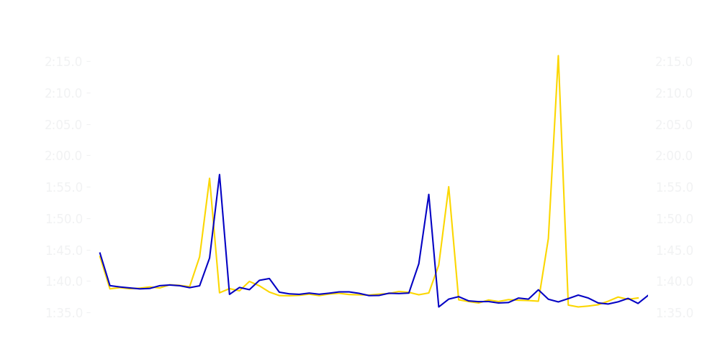
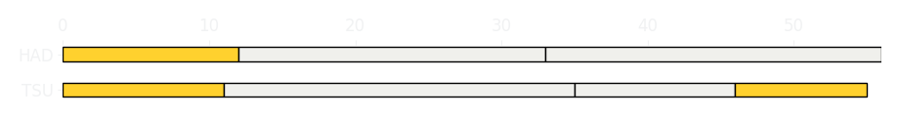
Chinese GP Race
Driver
Race Time
Race Time
Driver
Yuki Tsunoda
1:29:34.881
1:30:29.705
Isack Hadjar
Avg Lap Time
1:37.913
IQR
Gap
Gap
IQR
Avg Lap Time
1.84 s
+1 laps
-1 laps
1.772 s
1:38.018
Race Comparaison
Race Comparaison
Lap Advantage
32/56
Position
19
Safety Car Lap
0/56
Position
15
Lap Advantage
24/56
Lap Time Per Lap
Lap Time Per Lap
Tyre Strategy
Total Pit Stop Time
01:23.204 s
Pit Stops
3
Pit Stops
2
Total Pit Stop Time
00:45.130 s
Tyre Strategy

Slide 7


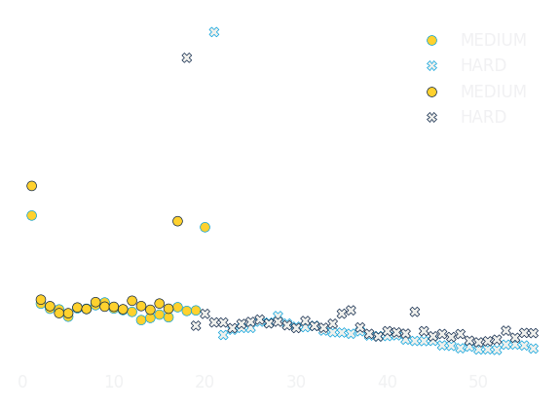

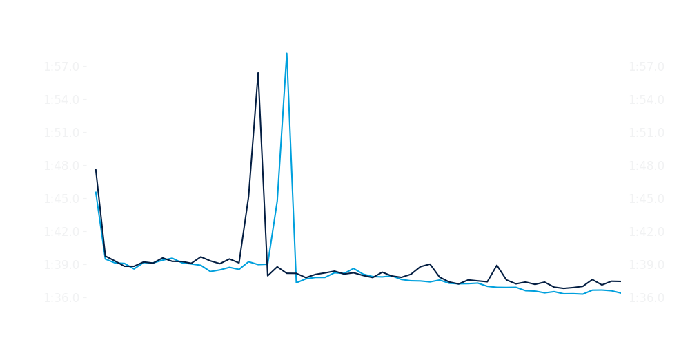
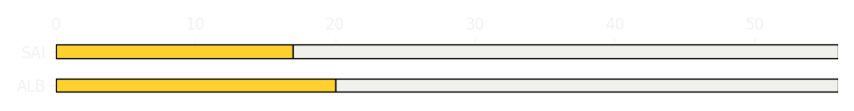
Chinese GP Race
Driver
Race Time
Race Time
Driver
Alexander Albon
1:30:06.074
1:30:24.101
Carlos Sainz
Avg Lap Time
1:37.798
IQR
Gap
Gap
IQR
Avg Lap Time
2.005 s
-20.066 s
+20.066 s
1.608 s
1:38.113
Race Comparaison
Race Comparaison
Lap Advantage
44/56
Position
9
Safety Car Lap
0/56
Position
13
Lap Advantage
12/56
Lap Time Per Lap
Lap Time Per Lap
Tyre Strategy
Total Pit Stop Time
00:23.362 s
Pit Stops
1
Pit Stops
1
Total Pit Stop Time
00:22.721 s
Tyre Strategy

Slide 8


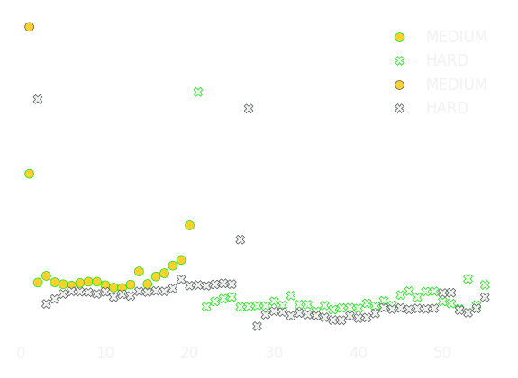

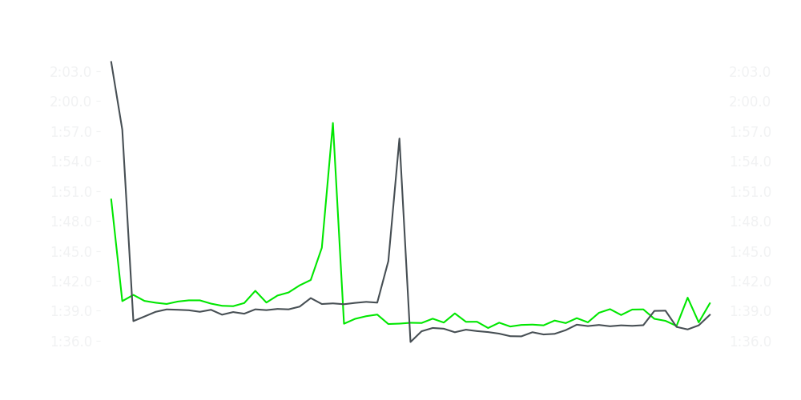
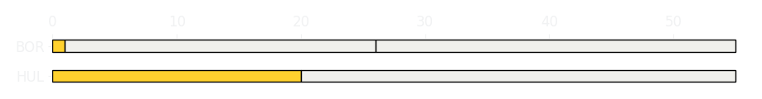
Chinese GP Race
Driver
Race Time
Race Time
Driver
Nico Hulkenberg
1:29:25.357
1:29:02.125
Gabriel Bortoleto
Avg Lap Time
1:38.736
IQR
Gap
Gap
IQR
Avg Lap Time
2.114 s
+09.470 s
-09.470 s
1.973 s
1:38.590
Race Comparaison
Race Comparaison
Lap Advantage
10/55
Position
18
Safety Car Lap
0/55
Position
17
Lap Advantage
45/55
Lap Time Per Lap
Lap Time Per Lap
Tyre Strategy
Total Pit Stop Time
00:22.959 s
Pit Stops
1
Pit Stops
2
Total Pit Stop Time
00:46.175 s
Tyre Strategy

Slide 9


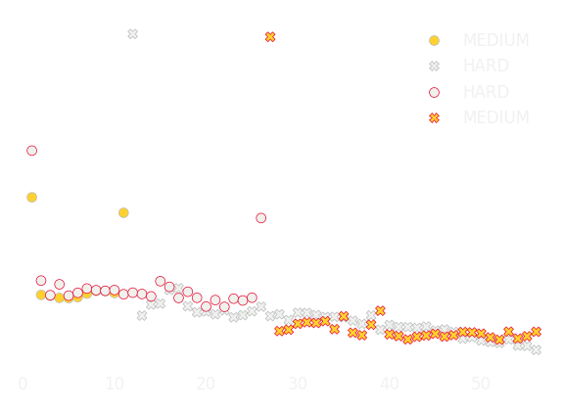
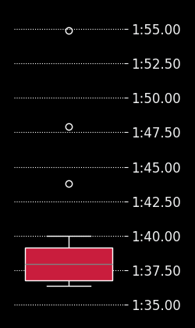
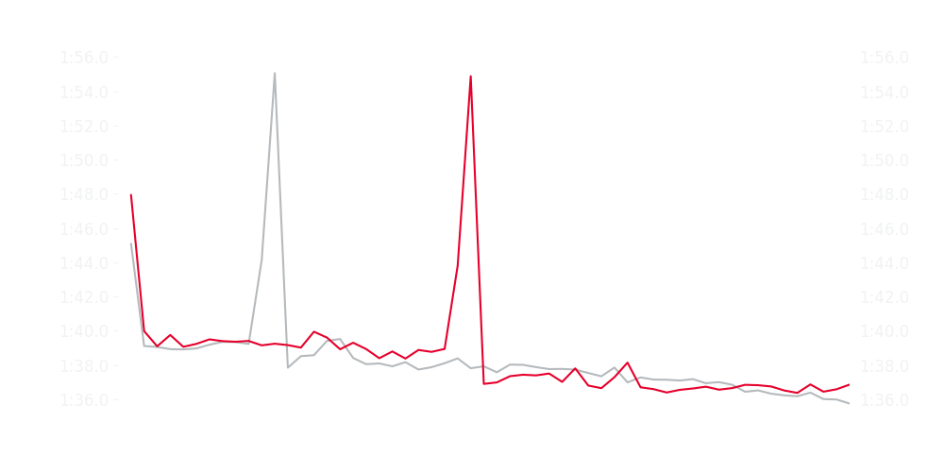
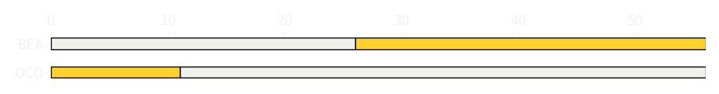
Chinese GP Race
Driver
Race Time
Race Time
Driver
Esteban Ocon
1:30:00.164
1:30:08.642
Ollie Bearman
Avg Lap Time
1:37.856
IQR
Gap
Gap
IQR
Avg Lap Time
1.531 s
-11.334 s
+11.334 s
2.397 s
1:37.965
Race Comparaison
Race Comparaison
Lap Advantage
35/56
Position
7
Safety Car Lap
0/56
Position
10
Lap Advantage
21/56
Lap Time Per Lap
Lap Time Per Lap
Tyre Strategy
Total Pit Stop Time
00:23.114 s
Pit Stops
1
Pit Stops
1
Total Pit Stop Time
00:22.808 s
Tyre Strategy

Slide 10


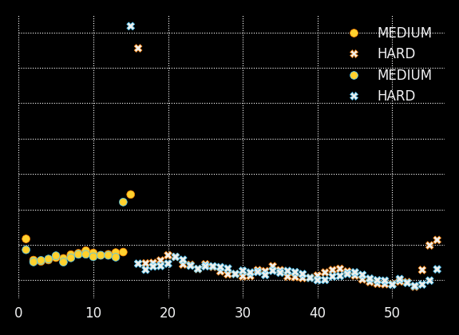

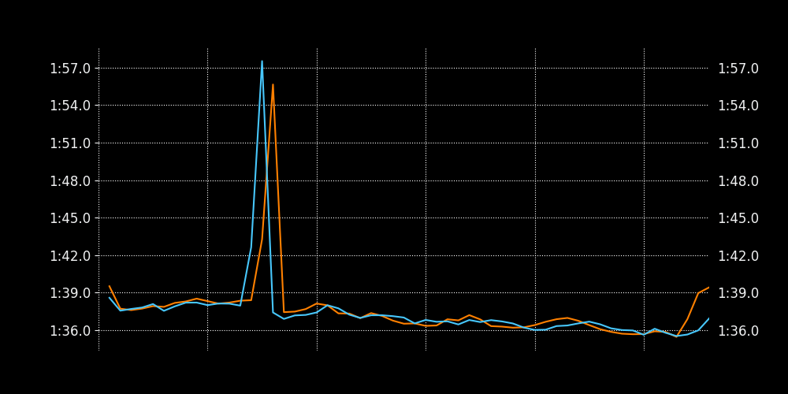
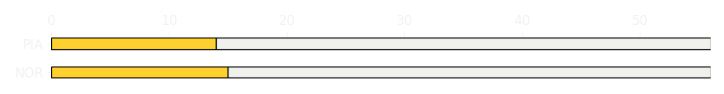
Chinese GP Race
Driver
Race Time
Race Time
Driver
Lando Norris
1:29:25.506
1:29:16.682
Oscar Piastri
Avg Lap Time
1:37.051
IQR
Gap
Gap
IQR
Avg Lap Time
1.625 s
+09.748 s
-09.748 s
1.273 s
1:36.912
Race Comparaison
Race Comparaison
Lap Advantage
25/56
Position
2
Safety Car Lap
0/56
Position
1
Lap Advantage
31/56
Lap Time Per Lap
Lap Time Per Lap
Tyre Strategy
Total Pit Stop Time
00:22.213 s
Pit Stops
1
Pit Stops
1
Total Pit Stop Time
00:23.938 s
Tyre Strategy

